Slide 1


KS4 Mathematics
N3 Finding Fractions of Quantities

Slide 2
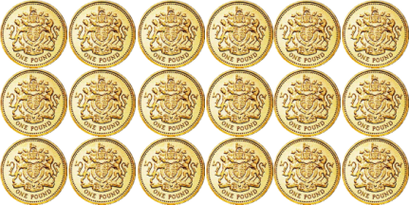
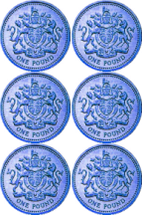

Finding a fraction of an amount
2
What is
of £18?
3
We can see this in a diagram:
2
of £18
= £18 ÷ 3 × 2
= £12
3
Notes:
Stress that ²/₃ means 2 lots of ¹/₃.
¹/₃ of £18 is £6 so, ²/₃ of £18 is 2 x £6.
Click to reveal £12.
Explain that we divide by 3 to find ¹/₃ and then multiply by 2 to find ²/₃.

Slide 3
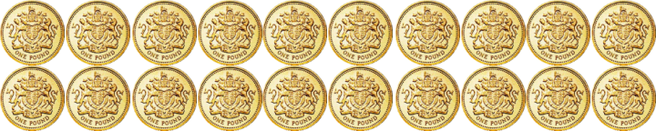

Finding a fraction of an amount
7
What is
of £20?
10
Let’s look at this in a diagram again:
7
of £20
= £20 ÷ 10 × 7
= £14
10
Notes:
Establish that ¹/₁₀ of 20 is £2.
The diagram shows each ¹/₁₀ being shaded until ⁷/₁₀ is shaded.
Establish that to find ⁷/₁₀ of £20, we divide by 10 (to find a ¹/₁₀) and multiply by 7 (to find ⁷/₁₀).

Slide 4
Finding a fraction of an amount
5
What is
of £24?
6
5
1
of £24
=
of £24
× 5
6
6
= £24 ÷ 6 × 5
= £4 × 5
= £20
Notes:
Remind pupils that ⁵/₆ means ‘5 lots of ¹/₆’ so we need to work out ¹/₆ of 24, by dividing 24 by 6, and then multiply that answer by 5.
Reveal each stage in the calculation.

Slide 5
Finding a fraction of an amount
4
What is of 9 kg?
7
4
To find of an amount we can multiply by 4 and divide by 7.
7
We could also divide by 7 and then multiply by 4.
4 × 9 kg =
36 kg
36
5
1
36 kg ÷ 7 =
kg
=
kg
7
7
Notes:
Remind pupils that we can multiply by the numerator and divide by the denominator in either order.
In this example, point out that 9 kg is not divisible by 7.
Let’s try multiplying by the numerator first and then dividing by the denominator.
Stress that 36 ÷ 7 is equivalent to ³⁶/₇. Writing this as an improper fraction allows us to write the answer as a mixed number. 36 ÷ 7 is 5 remainder 1 or 5¹/₇.
We could also write 5¹/₇ as 5.14 (to 2 decimal places).

Slide 6
Finding a fraction of an amount
When we work out a fraction of an amount we
multiply by the numerator
and
divide by the denominator
For example,
2
of 18 litres
= 18 litres ÷ 3 × 2
3
= 6 litres × 2
= 12 litres
Notes:
Tell pupils that it doesn’t make any difference whether you multiply first or divide first.
Demonstrate using the numbers in the example, that multiplying 18 by 2 and then dividing by 3 (this give us 36 ÷ 3 = 12) is the same as dividing 18 by 3 and then multiplying by 2 (this give us 6 × 2 = 12).
Establish that in this example if we divide first the numbers will be easier to work with.

Slide 7
Finding a fraction of an amount
2
1
What is of 3.5m?
5
2
To find of an amount we need to add 1 times the amount to two fifths of the amount.
1
5
2
1 × 3.5 m =
3.5 m
and
of 3.5 m =
1.4 m
5
1
2
so,
of 3.5 m =
3.5 m + 1.4 m =
4.9 m
5
7
We could also multiply by
5
Notes:
Discuss the meaning of 1²/₅ of an amount.
Go through the example on the board.
An alternative would be to convert 1²/₅ to an improper fraction, ⁷/₅. We could then divide by 5 to get 0.7 m and then multiply by 7 to get the answer 4.9m
Ask pupils if they can give you an equivalent decimal calculation (1.4 x 3.5 m) or an equivalent percentage calculation. (140% of 3.5 m).

